Slide 1

Identifying At-Risk School Districts with Machine Learning
Albert Lee

Slide 2
US primary/secondary education is very large.
800
Facts (2017)
18,811 School Districts
100,077 Schools
50,812,380 Students
US spending on primary/secondary education is comparable to US defense spending.
700
600
Education
500
Defense
Billions
U.S.D
400
Source
Local
300
State
200
Federal
100
0
2000
2005
2010
2015
Year

Slide 3
At-risk school districts make up small percentage, but have large impact.
Six percent of school districts in 2010 closed within 5 years.
This represents:
381,248 students
$4,032,423,000 spending

Slide 4
Supervised learning can be applied to identify at-risk school districts.
Objective:
Recall
Proportion of at-risk school districts that were correctly identified.
Precision
Proportion of school districts identified as at-risk that were actually at-risk.
Data:
Common Core of Data
Provided by National Center for Education Statistics
Includes all public/charter school districts (~18 thousand) for years 1995-2015
Contains over 200 variables
i.e. revenue sources, demographics, staff salaries
Notes:
Automating the financial coding process would allow ERS to more rapidly analyze school budgets.
This problem can be framed as a supervised learning problem.
Through DrivenData’s competition platform, an objective and a labelled dataset is provided.

Slide 5
Majority of work involved preprocessing and exploring data.
Preprocess Data
Explore Data
Test Models
Input data into data frame
Create labels
Encode missing and non-relevant values
Hypothesis Testing
Identify relevant features
Clustering
Logistic Regression
Gradient Boosting (XGBoost)
AutoML (TPOT)
Notes:
The competition was previously hosted in 2014, and the winning approach is documented on a DataCamp course.
I will first establish a baseline by replicating the results by completing the DataCamp course. Then I will complete EDA and test several deep learning approaches from scratch to see if I outperform the DataCamp course results.

Slide 6
Preprocessing Steps
Inputs:
Financial:
Includes revenues, expenditures, and debt
Universe:
Includes demographics and student size
Dropout:
Includes graduation and dropout rates
Financial 2010
Encode Missing and Non-Applicable Values
Universe 2010
Merged Data
Labeled Data
Tidy Data
Dropout 2010
Missing Values: NaN
Non-Applicable Values: 0
Universe 2015

Slide 7
Exploratory data analysis uncovered features to use for the machine learning model.
Numerical Features:
2-Sample T-Test
Categorical Features:
Chi-Squared Test
All Features (>200)
Numerical Features
Total Students
Total Schools
Total Teachers
Total Revenue
Total Federal Revenue
Total State Revenue
Total Local Revenue
Total Expenditures
Total Salaries
Minority Students
Male Students
Categorical Features
BIE District
Charter Status
Lowest Grade Level
Highest Grade Level
Metropolitan or Micropolitan area
Numerical Features
Total Students
Total Schools
Total Teachers
Total Revenue
Total Federal Revenue
Total State Revenue
Total Local Revenue
Total Expenditures
Total Salaries
Minority Students
Categorical Features
Charter Status
Lowest Grade Level
Highest Grade Level
Metropolitan or Micropolitan area
Remove features with excessive missing or non-applicable values
Conduct hypothesis tests to identify relevant features

Slide 8
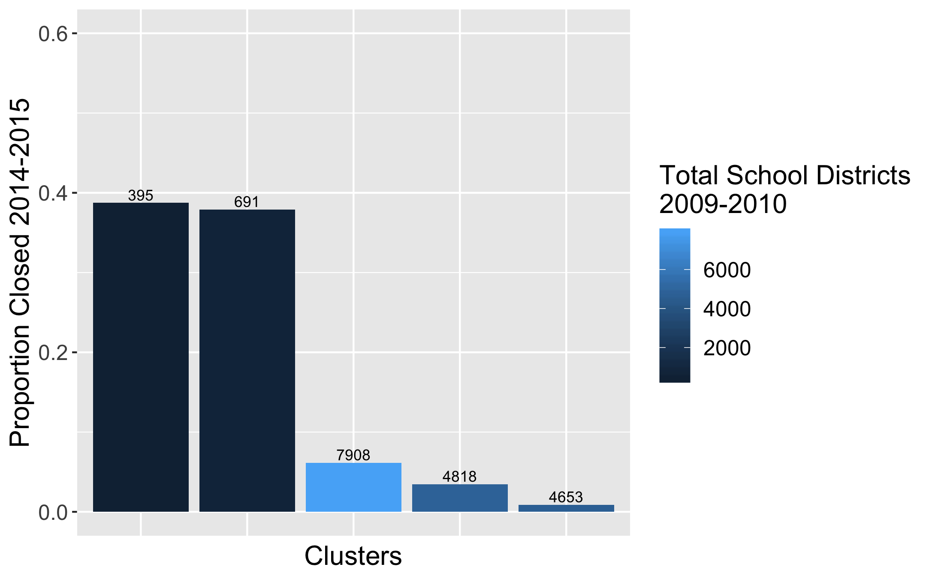
Even without using labels, clustering identified school districts more likely to close.
Applied K-Mean clustering to create 5 clusters.
Identified Clusters with higher “risk.”
Results:
Recall: 0.398
Precision: 0.411

Slide 9
Gradient boosting achieved high recall with precision tradeoff
Model | Recall | Precision
Logistic Regression 155 features, 387 with dummy variables | 0.043 | 0.429
Logistic Regression 155 features, 387 with dummy variables Min-Max Scaling | 0.116 | 1.000
Logistic Regression 155 features, 387 with dummy variables Min-Max Scaling Balanced Weighting | 0.841 | 0.221
XG Boost 155 features, 387 with dummy variables Min-Max Scaling Balanced Weighting PCA Imputation (median) | 0.810 | 0.239
XG Boost 15 features, 95 with dummy variables Min-Max Scaling Balanced Weighting Imputation | 0.848 | 0.232
AutoML with TPOT Optimize recall | 1.0 | 0.057
AutoML with TPOT Optimize f1-weighted | 0.4 | 0.84
Key Model Parameters:
Balanced Weighting
XG Boost Classifier
Reduced Feature Set
Results (on test set):
Recall: 0.848
Precision: 0.232
AutoML (TPOT) resulted in significantly higher precision (but lower recall)

Slide 10
Recommendations
Determine correct level of recall/precision tradeoff.
Set precision as satisficing constraint and recall as optimizing constraint.
Create heuristic to determine “cost” of type I error (false positive) relative type II error (false negative).
Test model on future years.
Calculate recall and precision on 2011 data once 2016 data is released.

Slide 11
Challenges and Lessons Learned
Allocate sufficient time to data wrangling tasks.
Use sklearn pipelines during model selection phase.
Experiment with AutoML.
Provide AutoML with appropriate optimizing metric.

